Slide 1
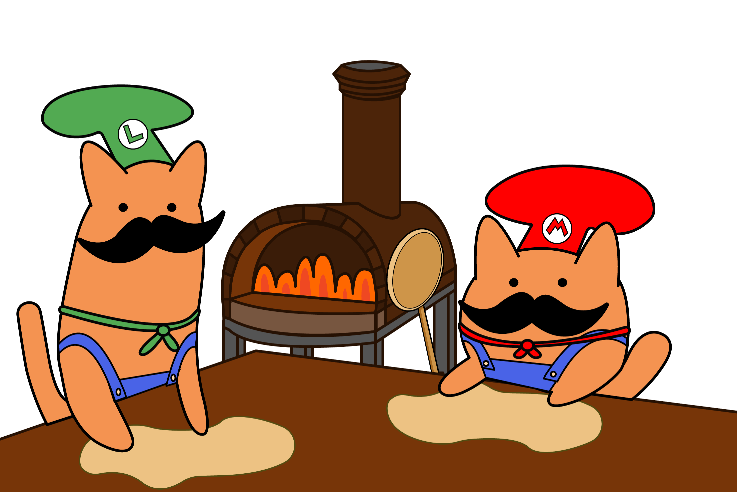

Pizzeria del Gatito

Slide 2
The problem and our amazing perfect solution
Employee Communication
Modernization
Client Satisfaction

Slide 3
Table of contents
Why our product
Demo
Group reflection
Individual reflection

Slide 4
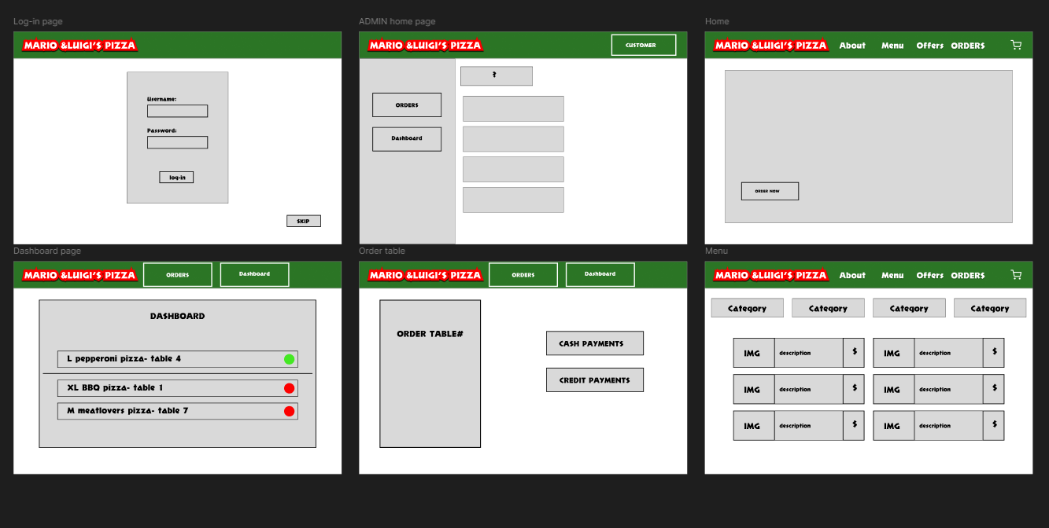
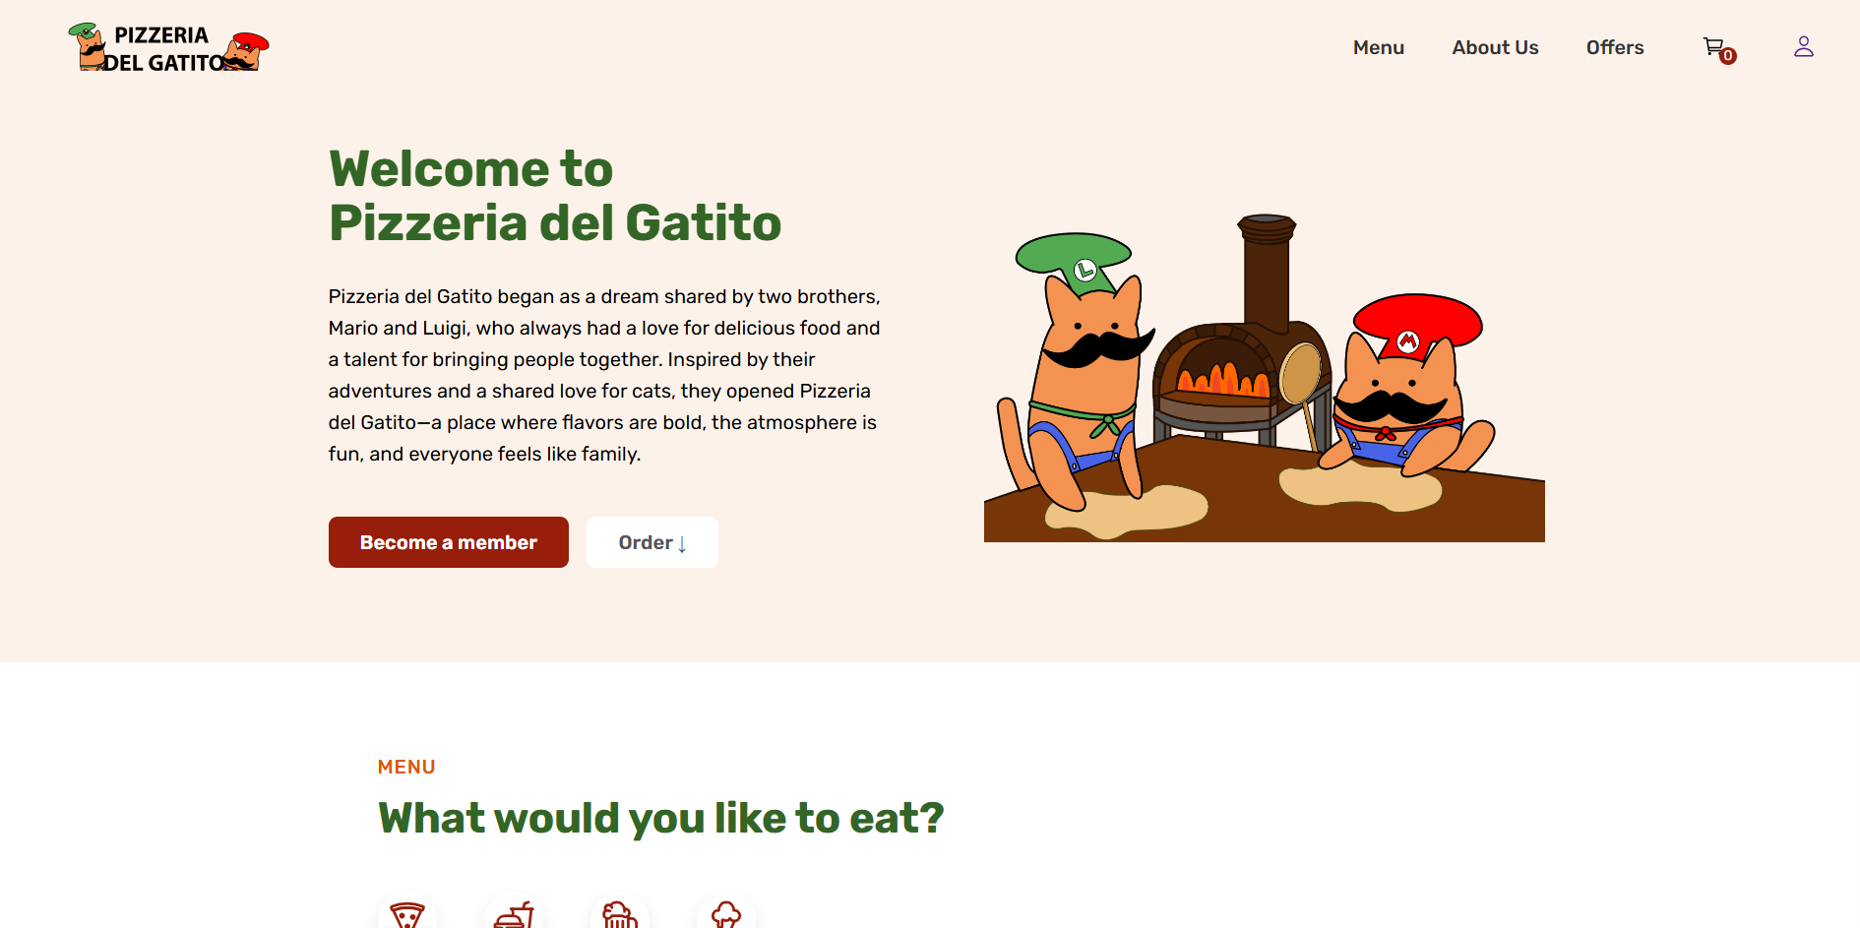
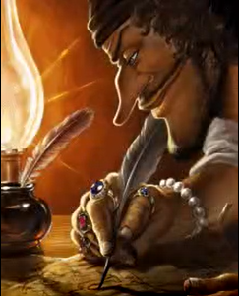
Our roles
Damian:
Iuri:
Benjamin:
Liander:
Mark:

Slide 5
Why our product?
User Friendly Interface
Well Documented
System designed for wider audience
Secure
Designed to reduce Mario’s workload
Dynamically generated menu’s

Slide 6
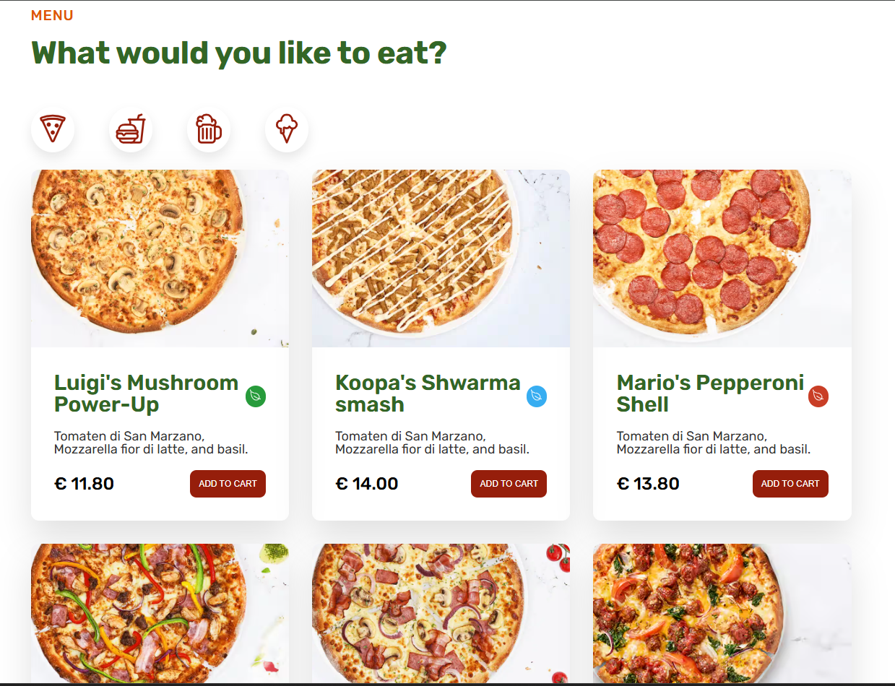
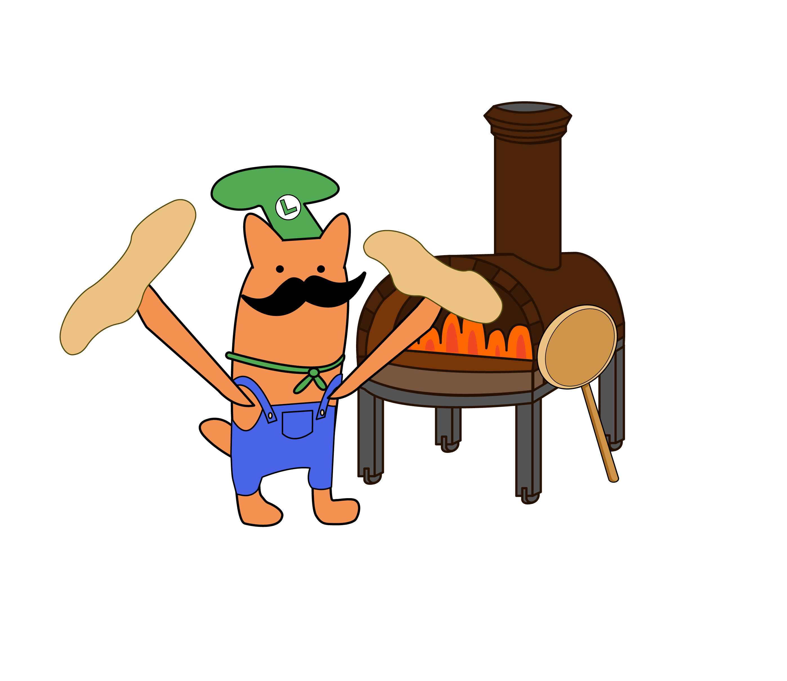
User Friendly Interface

Slide 7
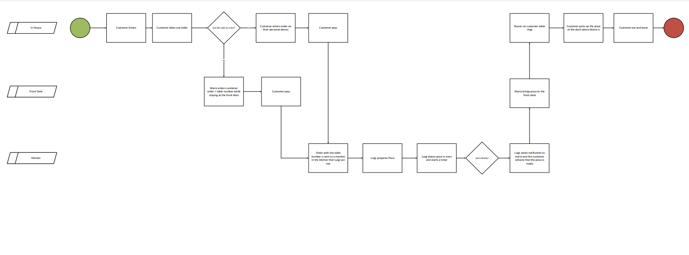
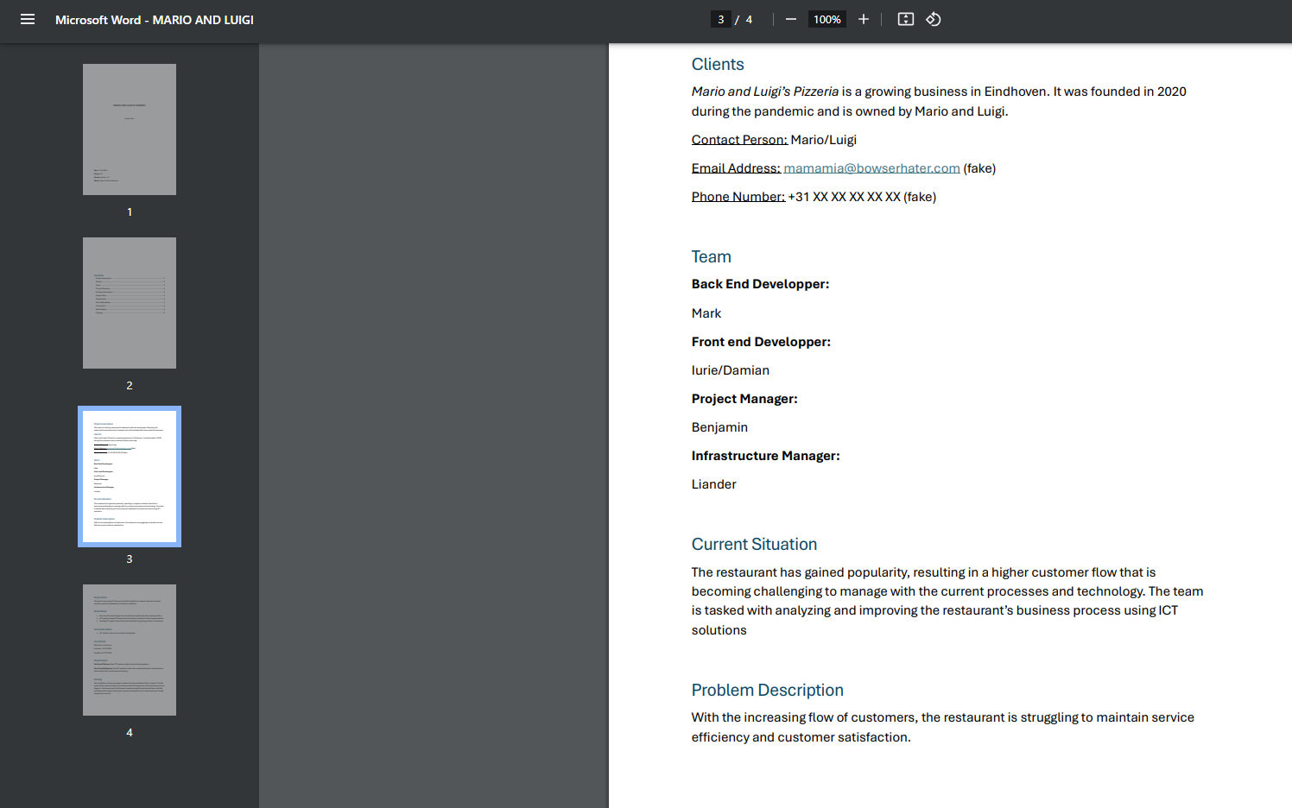
Well Documented
Project plan
Business diagram

Slide 8
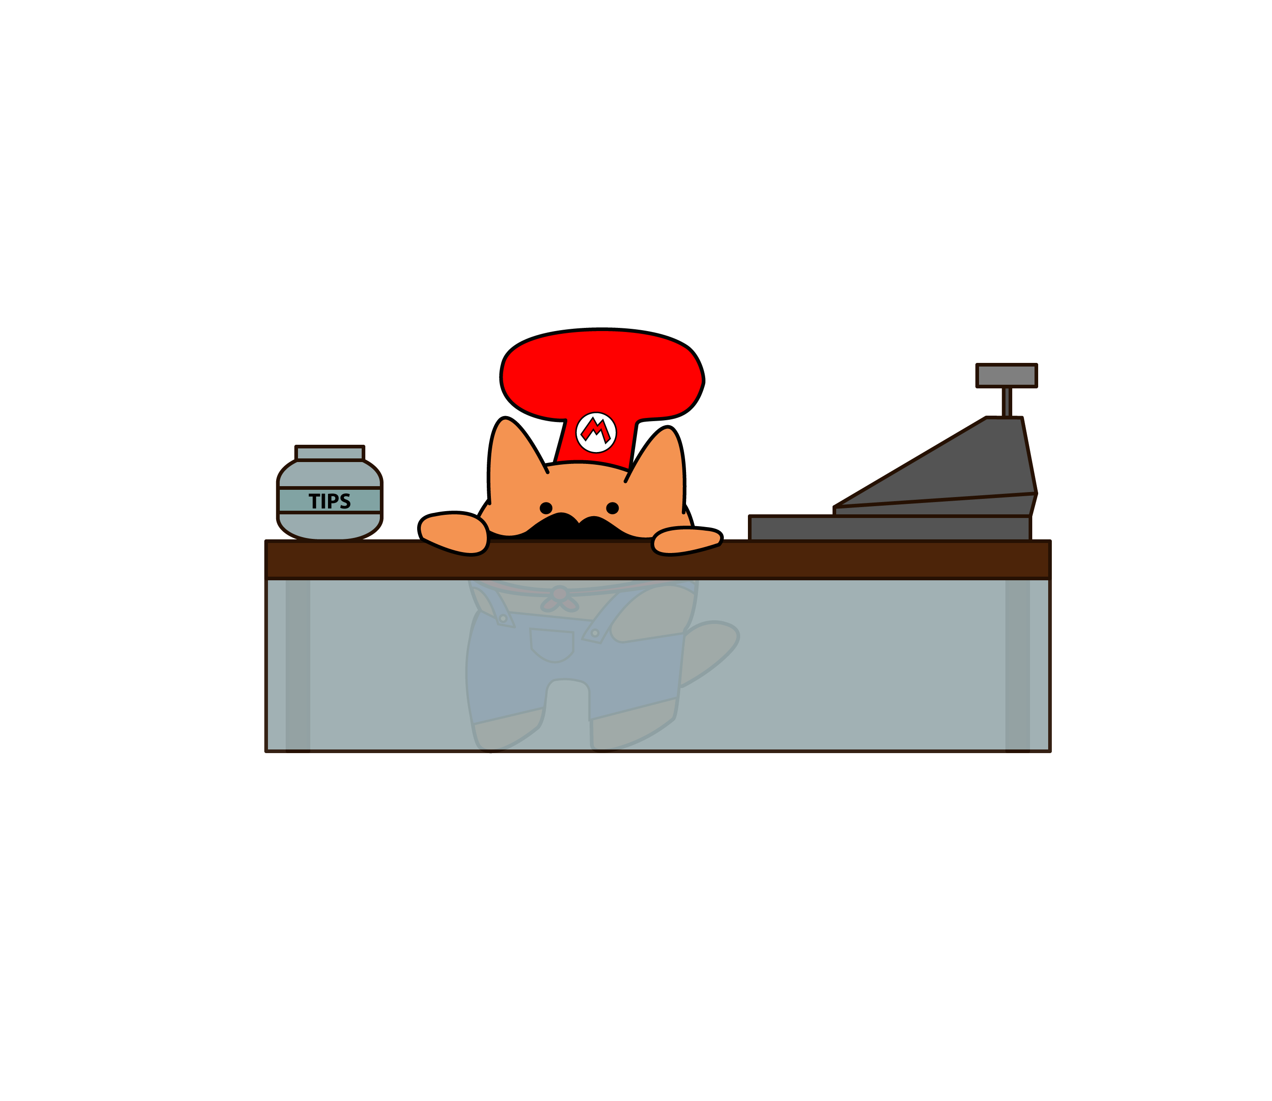
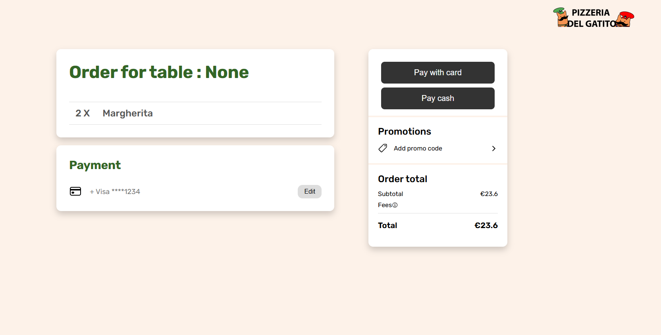
System designed for wider audience
Different payment options

Slide 9
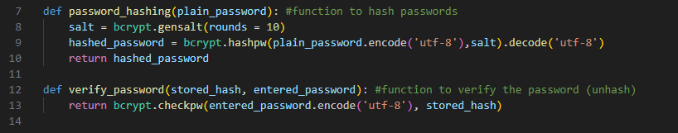
Secure
Proper SQL statements
Password hash
Randomly generated session key

Slide 10
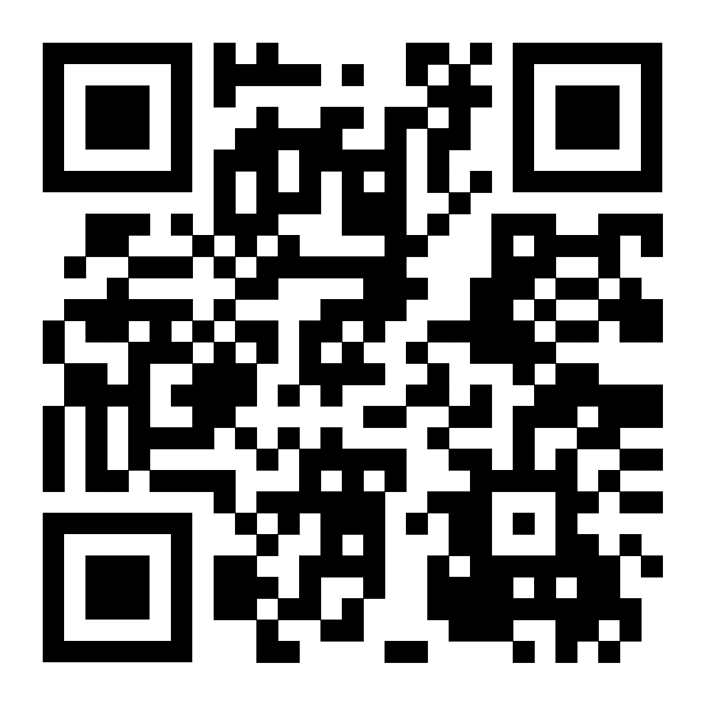
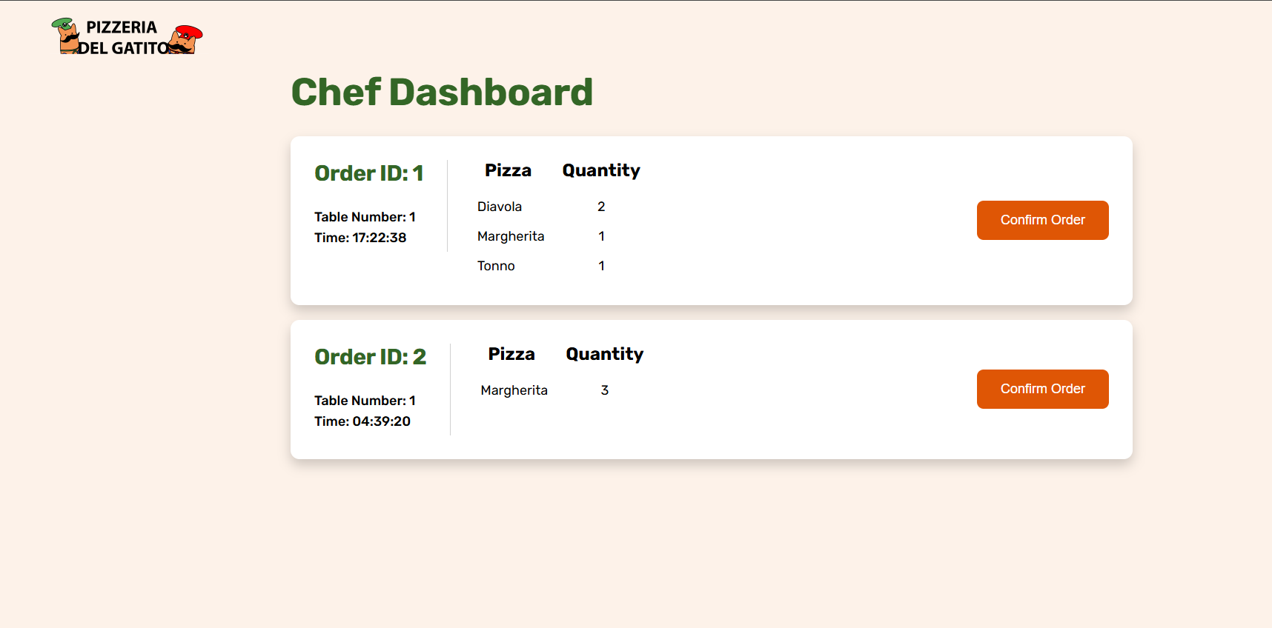
Designed to reduce Mario and Luigi’s workload

Slide 11
Individual reflection

Slide 12
Group reflection
What went well:
Group communication
Respecting deadlines
What could’ve gone better:
Equal task distribution
Debugging

Slide 13
